Slide 1
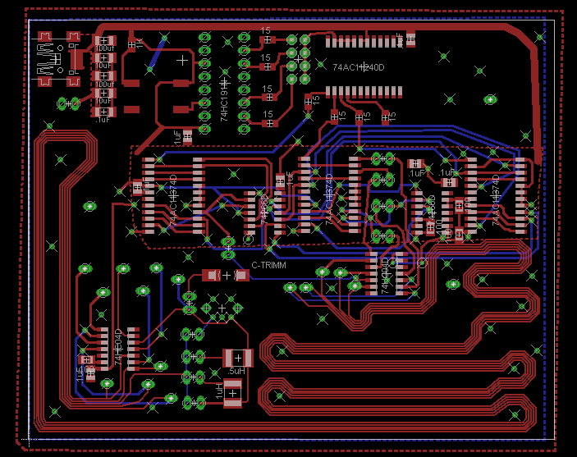
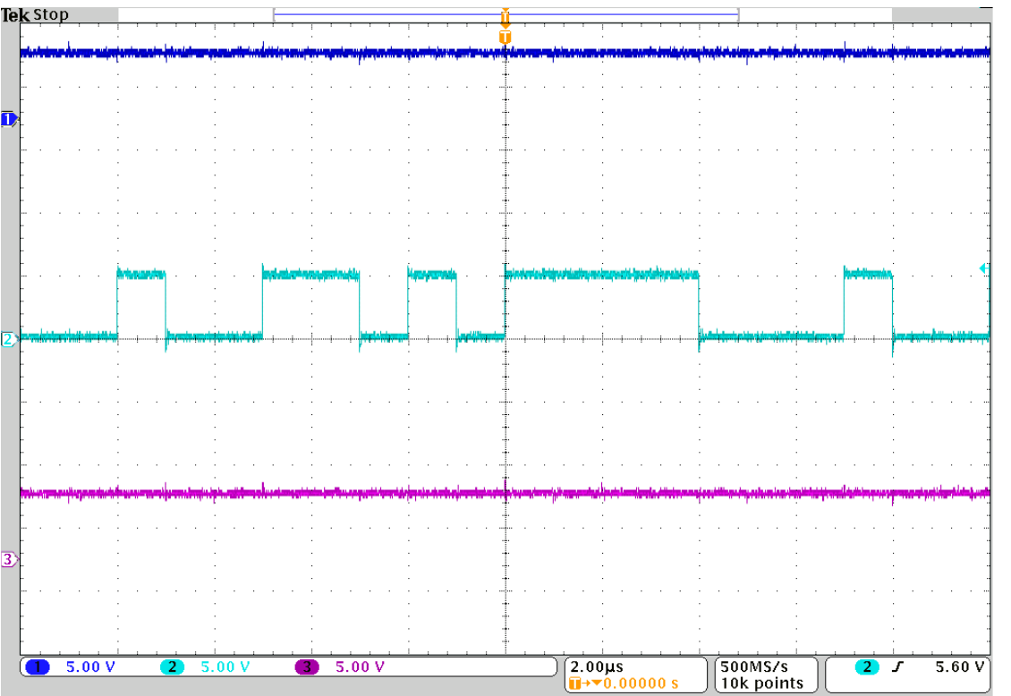
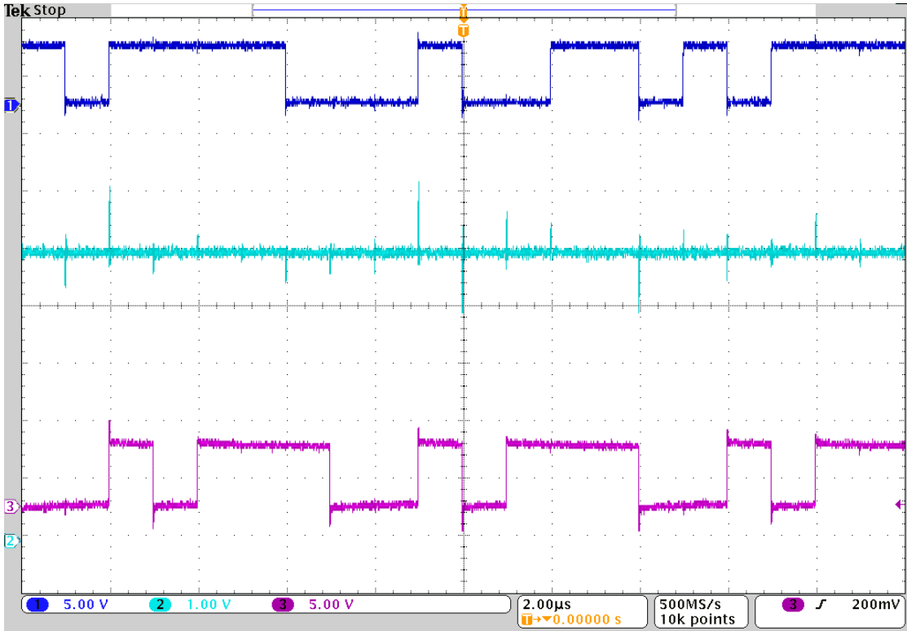
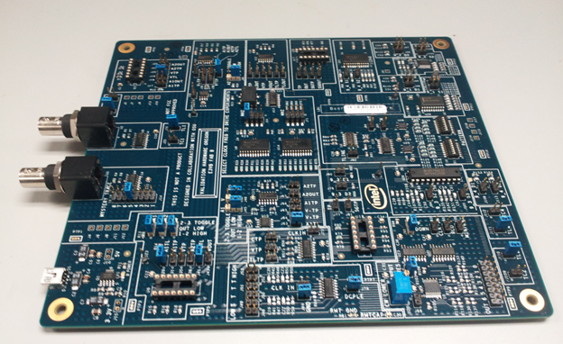
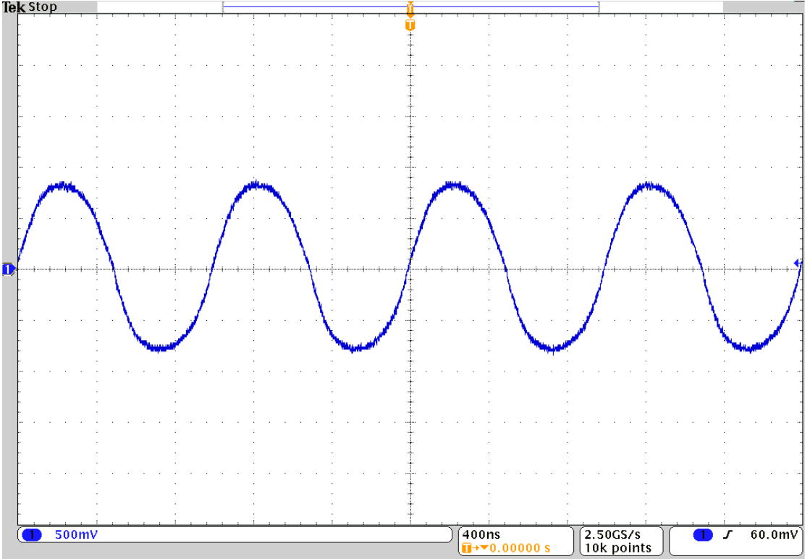
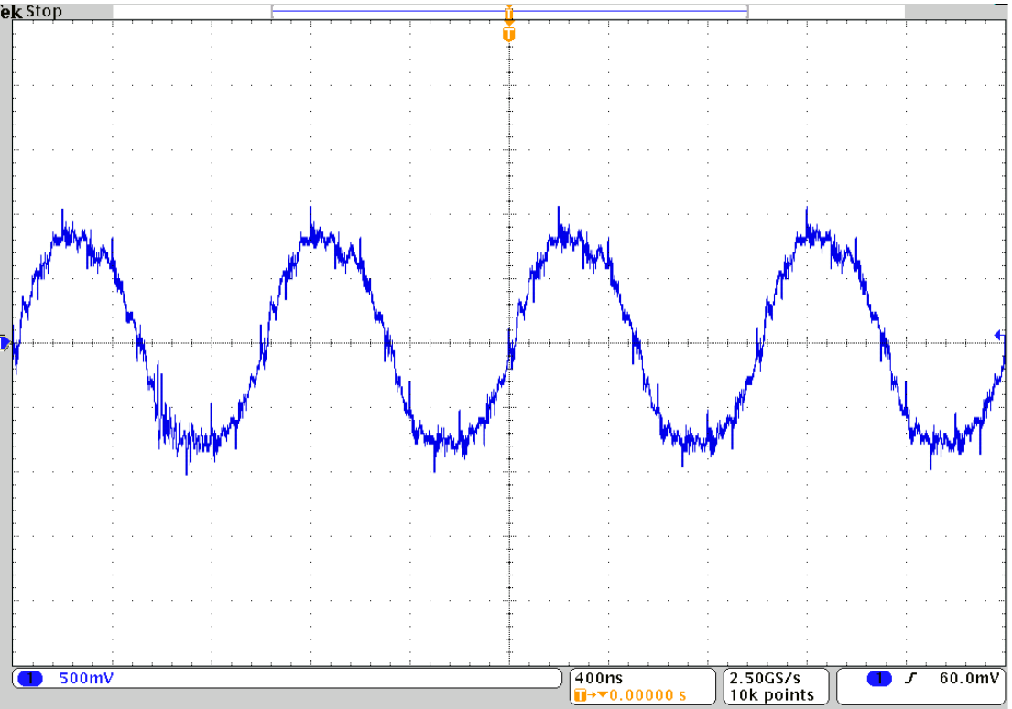
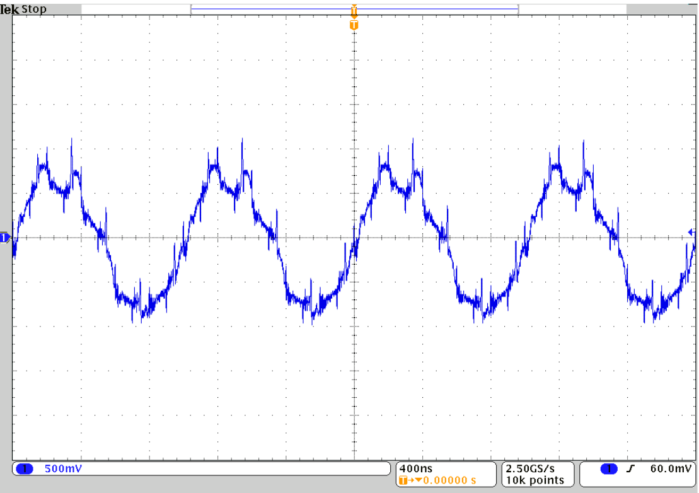

Signal Integrity Education
By: Travis Berger and Luis Santiago
Sponsor: Tony Muilenburg Advisor: Dr. James Morris
Background
Objective
In order for students and industry members
to build an intuition for signal integrity issues
Intel developed an educational board to demonstrate
these issues with a physical circuit. The Education
Engagement Electrical Validation Board E3VB
Helps bridge the gap between theory learned in the
classroom and common problems that occur
while measuring circuits the bench.
The objective of this capstone project was to help improve
the E3VB by adding new experiments to the existing board.
These experiments were required to work independently from
the E3VB but still be capable of being added to the E3VB
in a future revision .
Proposed New Experiments
Education Engagement
Electrical Validation Board
Mixed Signal Ground Technique The goal of this experiment is to highlight signal integrity issues that occur with improper grounding when a board contains both analog and digital circuity.
Analog signal without digital interference
Analog signal with isolated GND planes
Current Experiments
Crosstalk
Decoupling
Corners and Vias
Mystery Traces
Simultaneous Switching Noise
LCR Transmission Lines
Driver Circuit Comparison
Package Differences
Intersymbol Interference
Intersymbol Interference The goal of this experiment is to expand on the Intersymbol
Interference and the Crosstalk experiments currently on the E3VB.
This experiment uses four lines in parallel to show the effects of
aggressor lines on the signal integrity of the victim line. An LFSR is
used to create a random pattern generator.
Analog signal with shared return path
Department of Electrical and Computer Engineering

